Slide 1

Knowledge of P-N Junction Diode
Objectives
Name of the Faculty: Dr. Yogesh Kumar Program Name: B.Tech

Slide 2

School of Electrical , Electronics & Communication Engineering
Course Code :BEE01T1003 Course Name: BEEE
PN JUNCTION-DIODE
Name of the Faculty: Dr. Yogesh Kumar Program Name: B.Tech

Slide 3
School of Electrical , Electronics & Communication Engineering
Course Code :BEE01T1003 Course Name: BEEE
Theory of p-n junction
When a p-type semiconductor material is suitably joined to n-type semiconductor the contact surface is called a p-n junction.
P N
Depletion region
+ +
Name of the Faculty: Dr. Yogesh Kumar Program Name: B.Tech

Slide 4
School of Electrical , Electronics & Communication Engineering
Course Code :BEE01T1003 Course Name: BEEE
p-n junction as diode
The p-n junction is also called as semiconductor diode .
The left side material is a p-type semiconductor having –ve acceptor ions and +vely charged holes. The right side material is n-type semiconductor having +ve donor ions and free electrons
A K
Name of the Faculty: Dr. Yogesh Kumar Program Name: B.Tech

Slide 5
School of Electrical , Electronics & Communication Engineering
Course Code :BEE01T1003 Course Name: BEEE
Suppose the two pieces are suitably treated to form p-n junction, then there is a tendency for the free electrons from n-type to diffuse over to the p-side and holes from p-type to the n-side . This process is called diffusion.
The left side material is a p-type semiconductor having –ve acceptor ions and +vely charged holes. The right side material is n-type semiconductor having +ve acceptor ions and free electrons.
Name of the Faculty: Dr. Yogesh Kumar Program Name: B.Tech

Slide 6
School of Electrical , Electronics & Communication Engineering
Course Code :BEE01T1003 Course Name: BEEE
.
As the free electrons move across the junction from n-type to p-type, +ve donor ions are uncovered.
Hence a +ve charge is built on the n-side of the junction. At the same time, the free electrons cross the junction and uncover the –ve acceptor ions by filling in the holes.
Therefore a net –ve charge is established on p-side of the junction.
Name of the Faculty: Dr. Yogesh Kumar Program Name: B.Tech

Slide 7
School of Electrical , Electronics & Communication Engineering
Course Code :BEE01T1003 Course Name: BEEE
When a sufficient number of donor and acceptor ions is uncovered further diffusion is prevented.
Thus a barrier is set up against further movement of charge carriers. This is called potential barrier or junction barrier Vo. The potential barrier is of the order of 0.1 to 0.3V.
Note: outside this barrier on each side of the junction, the material is still neutral. Only inside the barrier, there is a +ve charge on n-side and –ve charge on p-side. This region is called depletion layer.
Name of the Faculty: Dr. Yogesh Kumar Program Name: B.Tech

Slide 8
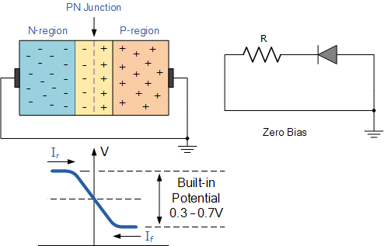
School of Electrical , Electronics & Communication Engineering
Course Code :BEE01T1003 Course Name: BEEE
Zero Biased PN Junction Diode
Name of the Faculty: Dr. Yogesh Kumar Program Name: B.Tech

Slide 9
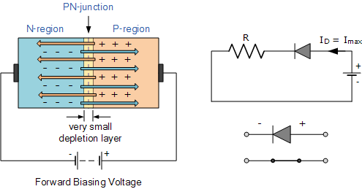
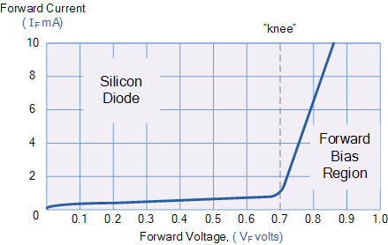
School of Electrical , Electronics & Communication Engineering
Course Code :BEE01T1003 Course Name: BEEE
Forward Biased PN Junction Diode
Name of the Faculty: Dr. Yogesh Kumar Program Name: B.Tech

Slide 10
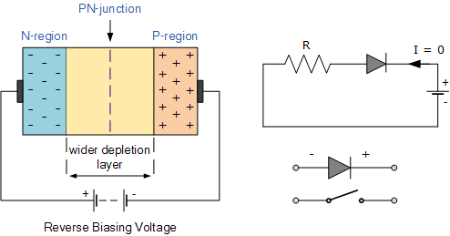
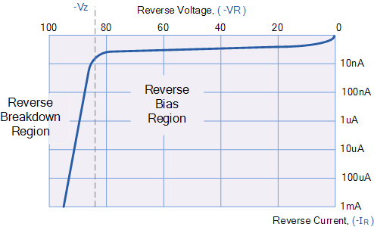
School of Electrical , Electronics & Communication Engineering
Course Code :BEE01T1003 Course Name: BEEE
Reverse Biased PN Junction Diode
Name of the Faculty: Dr. Yogesh Kumar Program Name: B.Tech

Slide 11
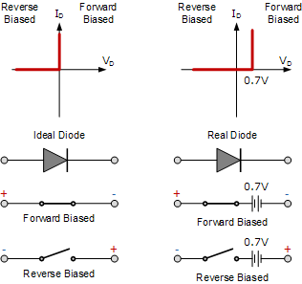
School of Electrical , Electronics & Communication Engineering
Course Code :BEE01T1003 Course Name: BEEE
Junction Diode Ideal and Real Characteristics
Name of the Faculty: Dr. Yogesh Kumar Program Name: B.Tech

Slide 12
School of Electrical , Electronics & Communication Engineering
Course Code :BEE01T1003 Course Name: BEEE
Diode equivalent circuit
It is generally profitable to replace a device or system by its equivalent circuit. Once the device is replaced by its equivalent circuit, the resulting network can be solved by traditional circuit analysis technique
Vo
switch
rf
VF
Name of the Faculty: Dr. Yogesh Kumar Program Name: B.Tech

Slide 13


